Slide 1

ISTE-330 - Team 7 - "FilmFinder"

Slide 2
Team members:
TEAM MEMBERS
Karlo Božikov
Filipa Ivanković
Fran Barišić
Vid Kraljić

Slide 3
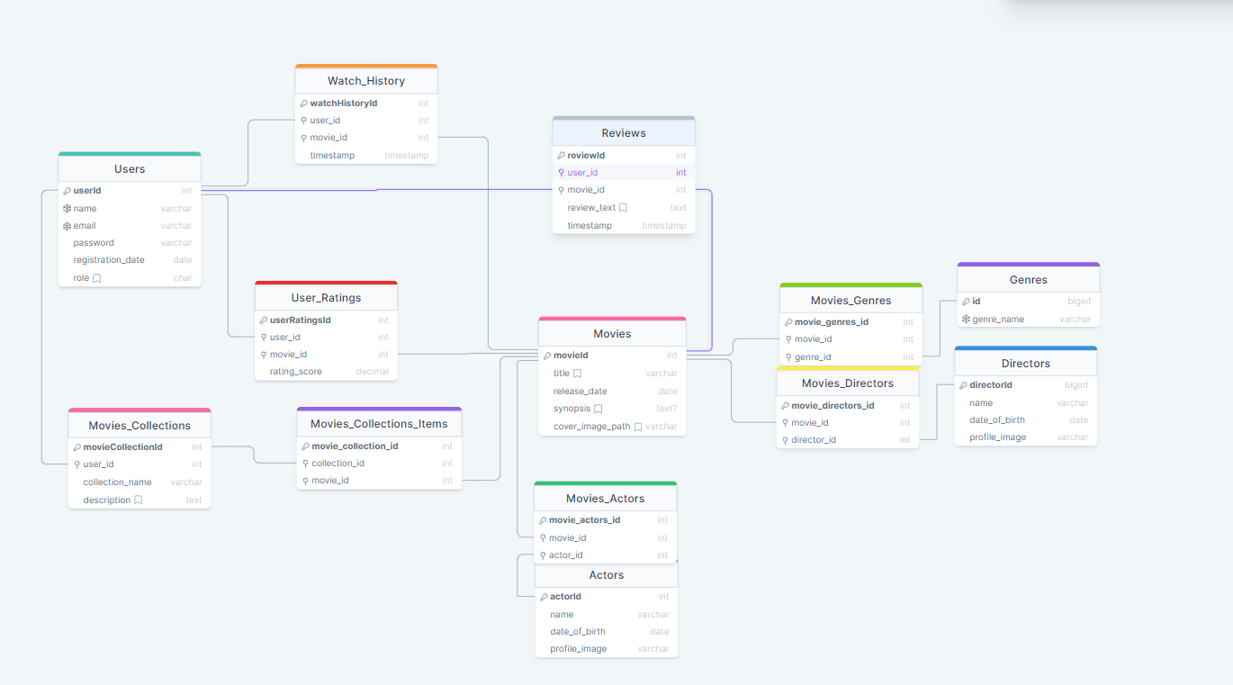
Notes:
DB model za ovaj projekt

Slide 4
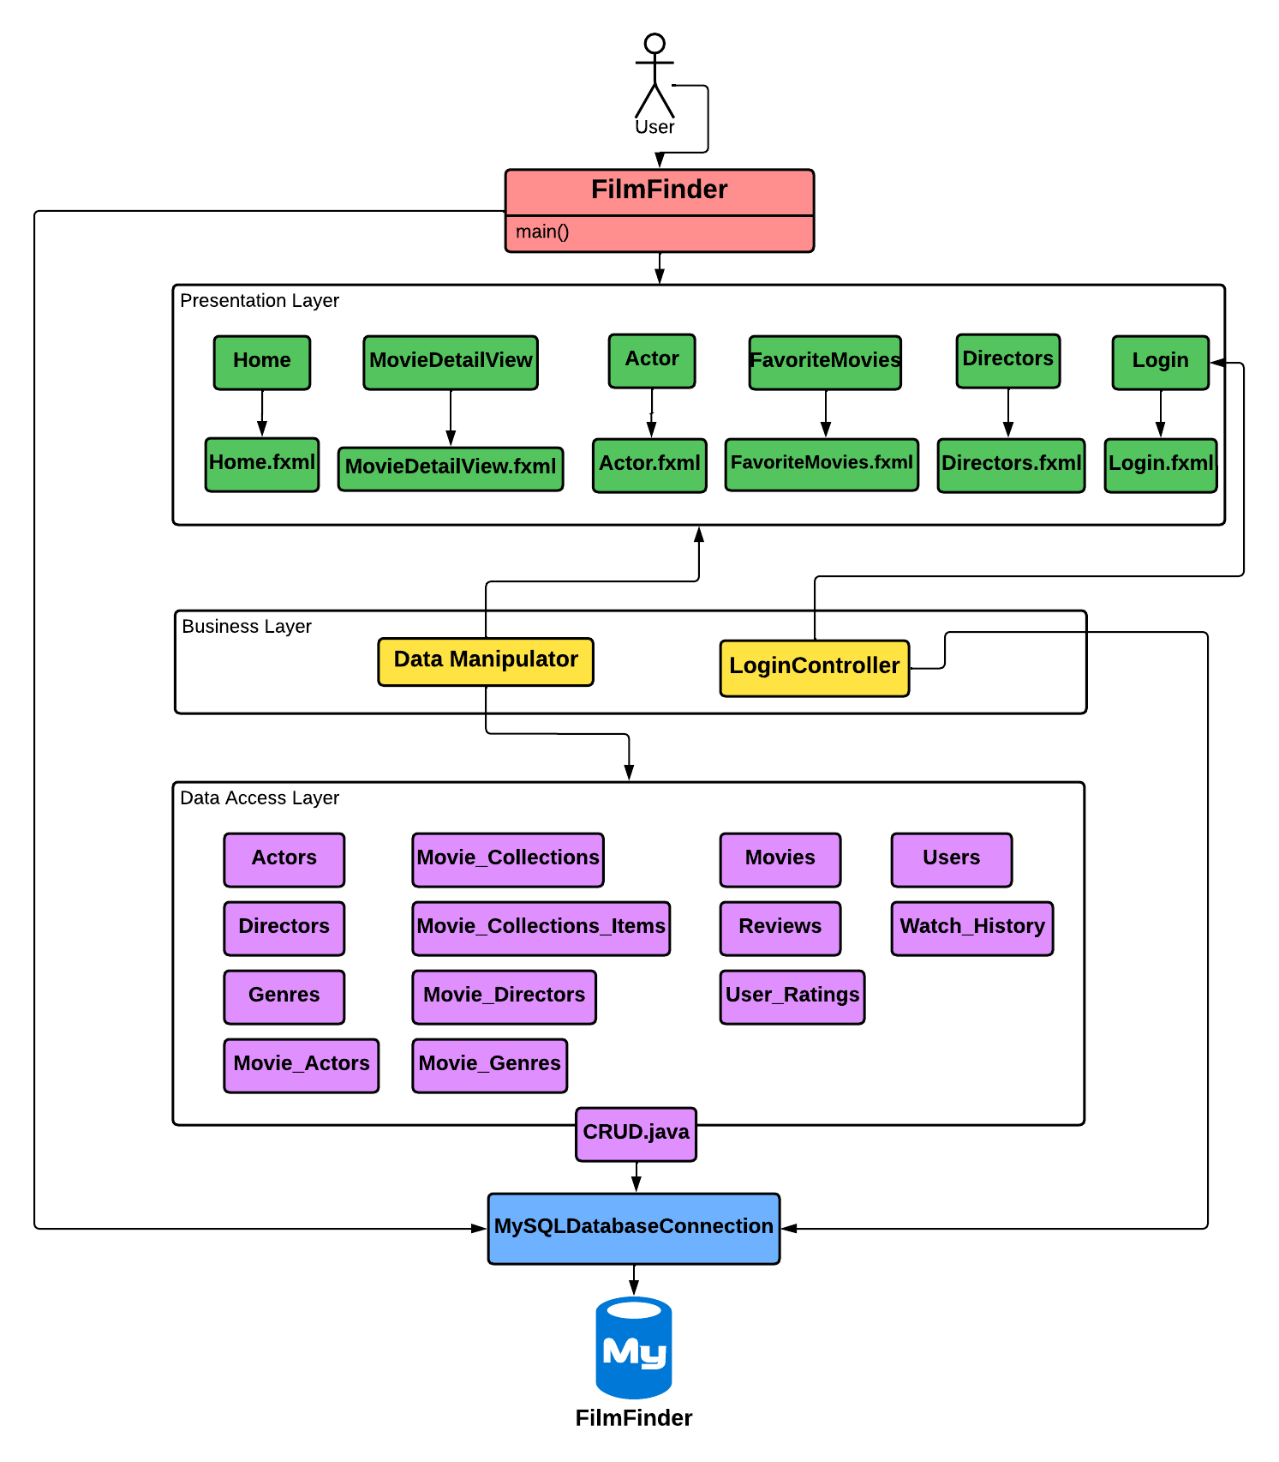
ERD DIAGRAM

Slide 5
Data Access Layer
Models for all Tables
Communicates with the Database
CRUD methods for manipulating data:
INSERT,UPDATE, DELETE,etc.

Slide 6
Business Layer
Objects of models provided to the Presentation Layer
A ton of methods which can find a particular collection of data that may be needed
Ability to search for wanted movies
Login functionality
Logged in users may add movies to their “Watch History”
The logged-in user may add a review to a movie
Users can log-out

Slide 7
Presentation Layer - GUI
GUI uses JavaFX as a platform of choice
GUI UX is designed to be simple and easy to use
Differences for which type of user is using the application:
3 levels of users: Guest/General, User and Admin
GENERAL - non-logged in users, can only view the data
USER - needs to login, has the ability to add movies to their lists, and leave reviews for the movie
ADMIN - needs to login, same abilities as user, but can also delete entries

Slide 8

Why JavaFx
Software platform for creating desktop applications
Support for a wide variety of devices
Cross compatibility with Mac, Linux and Windows
Good integration with

Slide 9
Things we are proud of
Data Access Layer - Each table is accessible, and data can be manipulated
Business Layer - Works without a hassle, and the Presentation Layer can easily get to the data it needs
Presentation Layer - Clean, simple and nice looking GUI
We actually managed to complete the project on time

Slide 10
Things that could have been improved
More of the Business Layer functionalities present on the GUI
Insert new movies/actors/directors, update existing movies/actors/directors
Movie Collections
Ability for users to make custom lists containing a selected set of movies

Slide 11
Problems encountered
Lost a team member -> certain functionalities got cut down
JavaFx turned to be much of a hassle than it needed to be
Team communication

Slide 12


Slide 13
Thank you for your attention!

